Slide 1






Symposium on Operating Systems Principles
MCon: Building an Elastic Cloud for Android Applications
with Framework Consolidation
Jiaxing Qiu¹, Zijie Zhou¹, Zhenhua Li¹, Hongyi Wang¹, Zizhang Liu¹, Yunhao Liu¹
Yumeng Liang², Jie Wu²˒³, Wen Xia⁴, Tianyin Xu⁵
1
2
3
4
5
1
Notes:
Hello, I'm Jiaxing Qiu from Tsinghua University. Today I'll present MCon, a system for building an elastic cloud for Android applications.

Slide 2
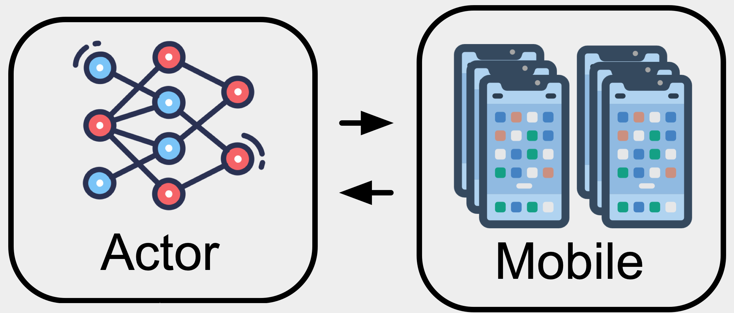
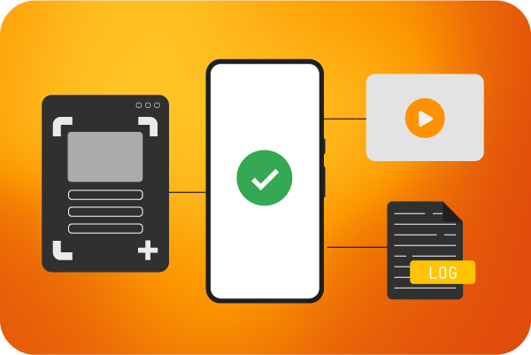
Mobile Cloud Computing Is Becoming Ephemeral
Mobile cloud computing is shifting toward short-lived workloads.
Long-running
virtual devices
Ephemeral
compute environments
GUI-agent training
Large scale app testing / CI
GUI actions + rewards
Parallel Android rollouts
Automated test runs
Results, video and logs
1
Provision
2
Deploy
3
Interact
4
Reset
Create many clean tenants
Install the target apps
Execute GUI actions
Record and start again
2
Notes:
The development of Mcon originates from our observation that mobile cloud workloads are becoming short-lived. Instead of keeping virtual phones running indefinitely, new workloads like GUI-agent training and large scale app testing increasingly need short, ephemeral Android environments running on Linux servers.
For example, a GUI-agent rollout follows the loop below: provision hundreds or thousands of clean tenants, deploy the apps, let the agent interact with them, then record the results and reset.

Slide 3
Mobile Clouds Need Two Kinds of Elasticity
React quickly to bursts—and keep large fleets cost-effective.
1. Low provisioning latency
2. High tenant density
Slow start
setup
Fast start
setup
Few tenants / host
Many tenants / host
time
Elasticity requires both fast allocation and a small per-tenant footprint.
3
Notes:
That gives us two complementary elasticity requirements for mobile clouds.
First, low provisioning latency: short jobs should not spend most of their time waiting for Android to start.
Second, high tenant density: each server should support many parallel environments at an affordable cost

Slide 4
Existing Mobile Stacks Fall Short
Commodity server: 2 × Xeon Silver 4210 (2.20 GHz) · 128 GiB RAM
RTX A4000 (16 GiB VRAM) · 4 TiB NVMe SSD
Slow to provision
Heavy to keep
>5 min
1.7–3.0 GiB
to boot 32 instances in a burst
host memory per idle baseline instance
For scale: minimal Linux containers
~17–33 ms per trivial run
MiB-scale memory
crun / runc: /bin/true lifecycle
e.g., 2.35 MiB in Docker’s nginx example
What’s wrong?
4
Notes:
Unfortunately, existing mobile stacks struggle on both dimensions. On our test server, booting a burst of thirty-two instances takes over five minutes. What’s worse, even an idle instance consumes gibibytes of host memory. Why is an Android environment so expensive before its app even starts working?

Slide 5
Root Cause: One Heavy Framework per Tenant
Android apps depend on a large, persistent userspace stack.
Tenant 1
Tenant 2
Tenant 3
60+
App
App
App
long-running processes
242
Framework
Framework
Framework
services
libraries
system state
services
libraries
system state
services
libraries
system state
system services
≈80%
Guest kernel / virtualization / host
of instance memory used by
the framework
(top-50 popular apps, average)
Every new tenant repeats framework initialization and residency.
5
Notes:
The main cost is the Android framework: a large userspace stack of services, libraries, and system state that every app depends on.
Android thirteen has over sixty long-running processes and two hundred forty-two system services. Even when running top-fifty-apps, the framework is still the biggest consumer of memory: it uses approximately eighty percent of total memory on average.
Conventional container stacks duplicate this framework for every tenant. Each copy must be initialized and kept resident.
How to solve the problem?

Slide 6
Why Not Just Pre-Warm or Snapshot?
These approaches reuse initialized state—but remain tied to device profiles.
Profile A
Profile B
Profile C
Profile D
request
Compact portrait
Fold / duo
Landscape
No matching
warm instance
•
Testing farms typically need to cover thousands of Android device models.
•
Warm capacity fragments; each instance retains a full framework.
Moreover, avoiding startup is not the same as removing duplication.
6
Notes:
There are plenty of work on fast container provisions in serverless computing, but they don’t work well in mobile scenarios, due to the need for diverse device profiles.
Boot-time configs like screen size, pixel density, refresh rate, CPU cores, memory size all affect app behavior, so testing and training need thousands of profiles to generalize.
Pre-warm and snapshotting works bad when there are many device profiles: suppose we have warm instances for A, B, and C, but a request for D still misses. Capacity becomes fragmented across profiles.
What’s worse, even when a request hits the warm cache, every active instance still carries a full framework and pays the memory price.

Slide 7
The Idea: Framework Consolidation
Turn the framework from a per-tenant component into a shared service.
Conventional mobile containers
MCon
Tenant 1 apps
Tenant 2 apps
Tenant 1 apps
Tenant 2 apps
Framework
Framework
One shared framework
Virtualization + host
Virtualization + host
Scope: single-provider clusters with semi-trusted tenants
Initialize once. Amortize the footprint. Add lightweight tenant contexts.
7
Notes:
So our idea is to rethink the mobile container architecture, about what to share and what not. What if we can let different tenants reuse one persistent framework?
That addresses both elasticity requirements: adding a tenant now avoids booting another full framework, and we can amortize the framework's memory cost across tenants.
The architecture comes with tradeoffs through. One thing is that shared Android framework becomes part of the trusted computing base, so a framework compromise can affect all co-located tenants. MCon therefore targets single-provider clusters with semi-trusted tenants, where compromises are unlikely and easy to audit.
The more important problem is that the Android framework is not designed for multi-tenancy. You see we don’t usually see ten people using the same smartphone, right?

Slide 8
Challenge 1: Isolating Tenant State
Android’s multi-user mode retains global names and device-wide state.
Name collisions
Cross-tenant visibility
Tenant 1
Tenant 2
Tenant 1
Tenant 2
App X · v1
App X · v2
View of running tasks
App Y
App X (own)
running
Shared package registry
Package X
v1
OR
v2
App Y (Tenant 2)
also visible
Different versions of X cannot coexist
Other tenants’ apps and tasks are visible
How can tenants share the framework without sharing one global view?
8
Notes:
Consequently, the Android system has single-user assumptions everywhere.
Consider two tenants installing different versions of app X. Android treats the package name as globally unique, so new installations either fail or overwrite existing packages. We don’t want our users to find out that their apps gets upgraded one day and fail to install another day.
These global data structures create another problem: one tenant can see another tenant's apps and activity.
It’s kind of scary to find out that your system actually hosts many applications that you didn’t install, and these apps could even get some idea of what you are doing.
We really need private views on a shared framework.

Slide 9
Why Not Modify the Android Framework?
Naive approach: make framework services and APIs tenant-aware.
Invasive API changes
Tenant awareness reaches into service internals.
7.5M
Broken app compatibility
lines of framework code
Existing apps depend on today's system interfaces.
Android, as of 2025
Ongoing maintenance
Revalidate the changes as Android evolves.
Even with coding agents, this remains a framework-wide refactoring problem.
Compatibility, isolation, and maintenance make the approach impractical.
9
Notes:
One approach would be to make every framework service tenant-aware. But the framework contains millions of lines of code.
Tenant awareness would reach into service internals and APIs, creating compatibility risks and ongoing maintenance work. Even with powerful coding agents, they do not remove the need to validate those changes.
So instead of refactoring every service, we look for a cleaner boundary where we can enforce each tenant's view.

Slide 10
Key Insight: Isolate at the IPC Boundary
Virtualize how apps perceive the system—before requests reach service logic.
Android
userspace
Framework service process
Unmodified
App Process
Transformed
arguments
Typed IPC
transformation
Existing
service logic
X → X.1
IPC request
IPC delivery
Android
kernel
Binder driver
•
Keep unmodified apps and existing service interfaces.
•
Avoid rewriting each service to understand tenants.
Isolation comes from virtualizing the interface—not duplicating the service.
10
Notes:
And that boundary is inter-process communication, or IPC. Recall that the framework service are separate userspace processes. The apps are too, and they communicate through the kernel's Binder IPC driver.
MCon inserts a proxy in the framework-side bindings. The proxy transforms IPC data before existing service logic sees them.

Slide 11
MCon > Framework Namespaces
Tenant 1
Tenant 2
App X v1
App X v2
IPC transformation
One shared Android framework
Namespace 1: private view
Namespace 2: private view
Guest
Host
Shared device stack (one host process)
vGPU
vDisplay
vInput
Shared host hardware
Private framework views. The device stack is still shared…
11
Notes:
We call the resulting abstraction a framework namespace. Each tenant gets a private view, but the framework itself is still shared.
First, let’s walk through an example.

Slide 12
MCon > Framework Namespaces > Private Views
Two versions of the same app can coexist without changing either app.
Tenant’s view
IPC transformation
Framework’s view
Tenant 1
App X v1
X → X.1
Package X.1
Return values: X.1 → X
Tenant 2
App X v2
X → X.2
Package X.2
Return values: X.2 → X
Each tenant sees package X. The shared framework sees distinct objects.
12
Notes:
So here’s the previous package conflict example. What MCon does is that, whenever an IPC call contains the package name X, MCon translates it to X dot one for tenant one, and X dot two for tenant two.
The shared framework therefore sees distinct packages, allowing different versions to coexist.
On the return path, MCon translates those internal names back to X, so the app does not need any modification.

Slide 13
MCon > Framework Namespaces > Transform Operations
10,511 APIs—Without 10,511 Handwritten Rules?
Give state a tenant-specific identity.
Virtualize
X → X.1; separate clipboard data
Hide objects from other tenants.
Filter
Package lists, tasks, events
Resolve device references to the tenant’s assigned devices.
Route
Display 0 → tenant 1’s display
Deny global or privileged changes.
Reject
Settings outside tenant authority
13
Notes:
The above example is one of the over ten thousand framework APIs Android has. How do we systematically understand what and how to transform, and avoid writing rules for every single API? To do this, we take a two-step procedure.
First, we find out that all IPC transformations fall under four types of generic operations, each for a different isolation purpose.
The example we just went through is an “virtualize” operation; virtualize provide tenant-specific views of identities or state, such as package names.
Filter deal with visibility problems by removing other tenants' objects.
Route deals with device slices, which we will talk about later.
Reject blocks privileged changes, for instance, a request to turn off Wi-Fi, because all tenants would lose Internet if allowed.

Slide 14
MCon > Framework Namespaces > Policy Mapping
Reason about tenant-scoped objects, then map the objects to operations.
10,511
878
79
framework APIs
framework object types
tenant-scoped types
Examples of framework objects:
Global objects: Android version
Tenant-scoped objects: package name X → X.1
Build-time API classification
8,038 pass-through · 76.5%
2,473 transformed
~20 developer-hours
Android 13 to 15 policy-engine migration
14
Notes:
Next, we map the four operations to the APIs. But instead of reasoning about them individually, we reason about the much smaller set of about eight hundred framework objects.
In particular, we identify global and tenant-scoped objects. Android version is a global object: it means the same for every tenant and can pass through unchanged. The meaning of a package name, however, is scoped to a particular tenant and needs transformation.
Then, we only need to transform those APIs whose arguments contain such tenant-scoped objects. Overall, about three-quarters of APIs pass through; the remaining quarter are transformed.
Because the framework-object surface is mostly stable, the effort it takes to migrate between Android versions is manageable, within tens of developer hours according to our experience.

Slide 15
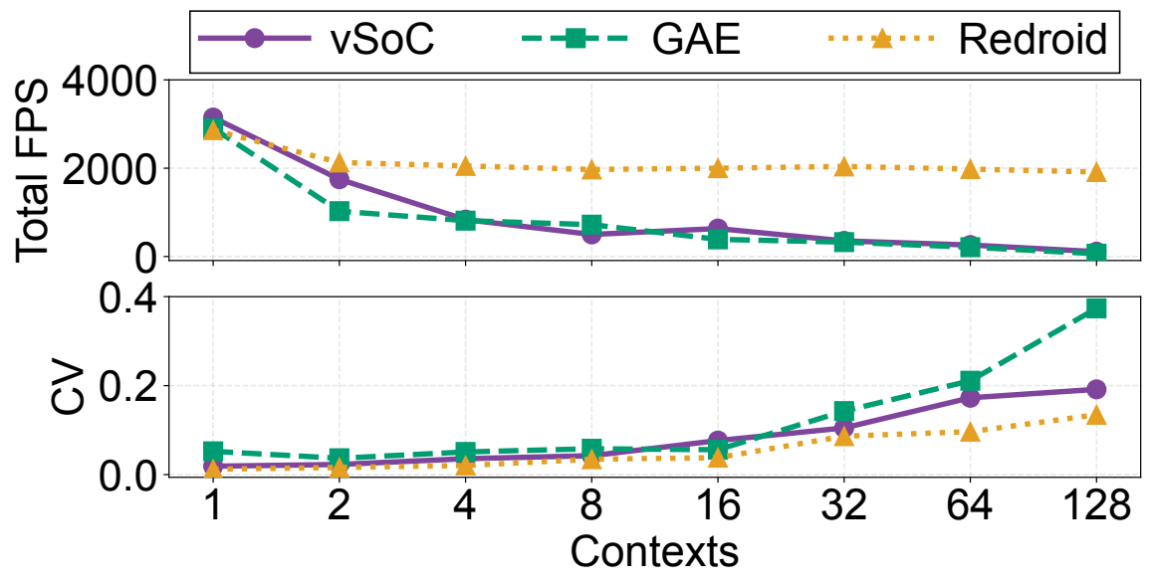
Challenge 2: Shared Device-Stack Contention
Private framework state does not prevent device-stack contention.
Shared device stack
Existing graphics backends
Tenant 1
Tenant 2
Tenant 3
One shared host process
Lock contention
Paravirtualized virtual devices
Global locks
vGPU · display · input · audio
Host GPU driver
Global locks
NVIDIA user-space driver
At 128 contexts (vSoC / GAE):
2.2–3.5% of peak FPS
38–46% of CPU time in synchronization
Shared physical GPU
More threads hit shared locks; one thread trades contention for a CPU ceiling.
15
Notes:
Enough on the framework namespaces. As our architecture enables much higher tenant densities, another important problem arises: we observe that per-tenant performance drops dramatically at high tenant densities.
That is because the sheer volume of commands flood one host process, which puts huge stress on process-wide locks in virtual devices and GPU drivers.
But framework namespaces work at a higher level and do not eliminate device contention.

Slide 16
MCon > Share the Framework, Slice the Devices
Tenant 1
Tenant 2
App X v1
App X v2
IPC transformation
One shared Android framework
Namespace 1: private view
Namespace 2: private view
Guest
Host
Device slice 1 (vhost-user)
Device slice 2 (vhost-user)
vGPU
vDisplay
vInput
vGPU
vDisplay
vInput
Shared physical GPU and host hardware
Separate processes remove cross-tenant process-wide lock contention.
16
Notes:
So we need to change the lower half of the architecture. The framework remains shared, but each tenant receives a virtual device slice in a separate host process.
A device slice is a set of virtual GPU, display, input, and other devices dedicated to one tenant. The namespace routing operation (that’s the third operation that we previously mentioned) pins a slice to a particular framework namespace.

Slide 17
MCon > Virtual Device Slices
Hotplug devices and bind a namespace without restarting the VM or framework.
Slice creation and hotplug
1
Customize
Choose device properties
2
Spawn
Create a slice process
3
Interrupt
Notify the guest kernel
4
Hotplug
Register virtual devices
5
Bind
Associate the namespace
6
Start
Launch the tenant’s app
Slices start in <50 ms and add <1% memory overhead.
17
Notes:
The rationale for slicing devices is that they are light: they start in less fifty ms and have small overhead.
Creating a slice follows a few steps. When the hypervisor receives a request to allocate a particular device profile, it spawns a host process.
The hypervisor notifies the guest, which then hotplugs the devices. MCon then either creates a namespace or reuses a namespace from a warm namespace pool. Note that Mcon can apply pre-warming techniques to further accelerate provisioning because namespaces are profile-agnostic.
The namespace is then bound to the slice, and the tenant's app is started. And that’s how device slices work.

Slide 18
Device Slices Still Share the Physical GPU…
Work piles up in proprietary NVIDIA driver queues that MCon cannot control.
Shared queueing makes frame completion irregular within each slice.
Concurrent submissions
Outside MCon’s control
Slice 1
NVIDIA driver / shared GPU queues
Physical
GPU
Slice 2
Slice 3
Queue buildup · opaque scheduling
Per-slice jitter: uneven gaps between completed frames
Slice 1
Slice 2
Slice 3
18
Notes:
Virtual device slices isolate virtual devices, which is great, but that’s not the full story. Separate slices still share the physical GPU.
Their commands can accumulate in GPU driver queues, creating uneven gaps between different GPU frames. The gaps create janky frames that makes interactions with the system visually laggy.
How to achieve steadier per-tenant performance? The hard problem is that the NVIDIA GPU scheduler is proprietary and is not really accessible from high-level graphics APIs like OpenGL and Vulkan, where Mcon’s virtual devices operate on.
So instead, MCon uses an application-level scheduling mechanism.

Slide 19
MCon > Virtual Device Slices > Complexity-Aware Frame Pacing
Pace each slice in userspace, before commands enter the shared driver queues.
MCon controls waiting inside each slice
Slice 1
Userspace queue
Outside MCon’s control
Pace
NVIDIA driver
Shared GPU queues
Slice 2
Userspace queue
Physical
GPU
Pace
Slice 3
Userspace queue
Opaque scheduling
Pace
1
Estimate frame work
2
Measure GPU time
3
Set the next delay
time / complexity
Adjust delay
C
Frame
Wait
Next frame
Fragment
Vertex
Compute
K
Weighted shader invocations
Sliding minimum K → GPU time = C × K
PI feedback + per-tenant target
19
Notes:
Essentially whenever we detect the GPU queues are busy, we keep subsequent frames waiting inside each slice, before commands enter the shared driver queues. The important thing to calculate is how much time to wait? To get that we uses a three-step mechanism.
First, we estimate frame work, in relative units, using shader invocation counts.
Second, we measure how much GPU time it actually takes for one unit of work to finish. Because measured times can include scheduling delays, we track the sliding minimum of unit time, based on the principle that a unit of work can never take less time to complete than what is physically required.
Third, a feedback controller uses that estimate to adjust the delay before the next frame.

Slide 20
Evaluation Setup
Four representative baselines
Mobile containers
Mobile emulators
Redroid
vSoC
Anbox Cloud
Google Android Emulator
Top-50 Android apps
One commodity server
Random and synchronized app mixes
Repeated trials; increasing tenant density
128 GiB host RAM · RTX A4000 (16 GiB)
Full HD · 420 DPI · 60 Hz · offscreen
20
Notes:
We evaluate MCon against four representative systems, with top-50 popular Android apps as the workload.

Slide 21
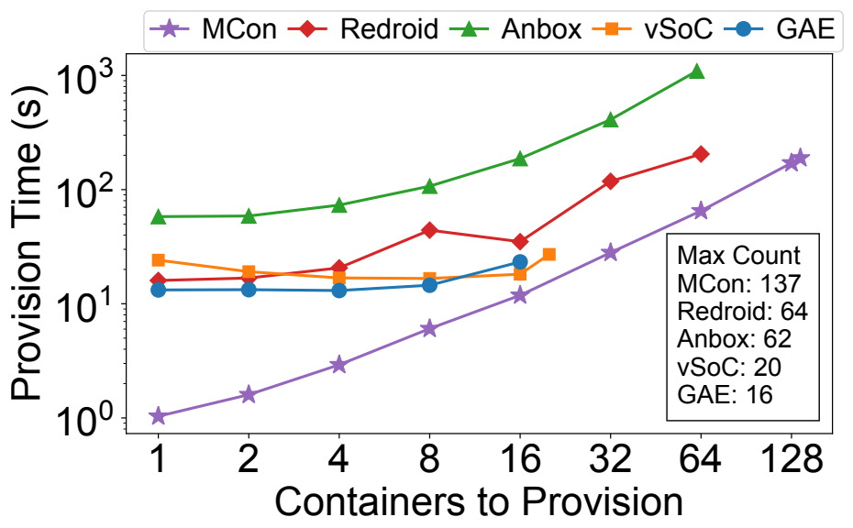
Cold Tenant Allocation in 0.99 Seconds
A new tenant on a running MCon platform—not a cold boot of the whole system.
0.99 s
single-tenant allocation
15–58×
speedup over the
evaluated baselines
No per-tenant framework boot: hotplug devices, create ns context, launch.
21
Notes:
First, provisioning latency. MCon allocates one tenant in zero point nine nine seconds, fifteen to fifty-eight times faster than the baselines.
We achieve this because we don’t need to cold boot the framework; we hotplug devices, create namespaces, and launch apps.

Slide 22
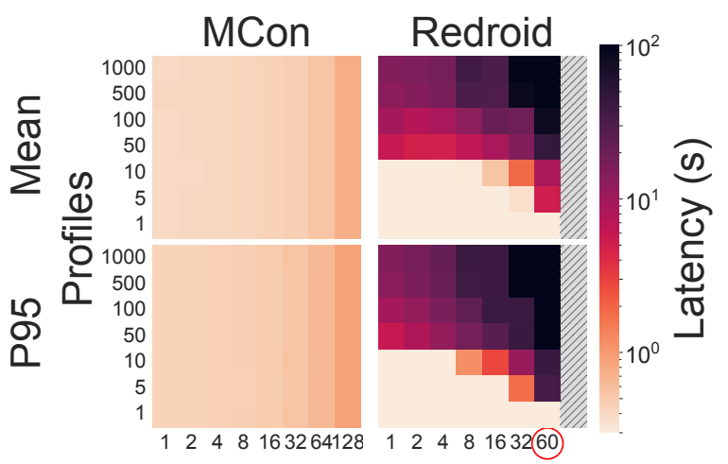
Fast Provisioning Across Device Profiles
Profile-specific warm pools work well—until requests miss the available profiles.
One profile
Matching baseline requests
can start in <10 ms.
Many profiles
MCon’s mean and P95
remain sub-second
across 1–1,000 profiles.
Concurrent requests
Any pre-allocated namespace can bind to the requested device slice.
22
Notes:
What happens when we allow pre-warming? These heatmaps compare MCon and Redroid, the best performing baseline.
With one profile, Redroid’s warm pool almost always hits and performance is really good---even better than MCon. As profile diversity grows, Redroid’s warm pools start to miss requests, increasing tail latency and then average latency.
MCon instead pre-allocates namespaces that can bind to any requested device slice. Therefore, its latency is consistent and profile-agnostic.

Slide 23
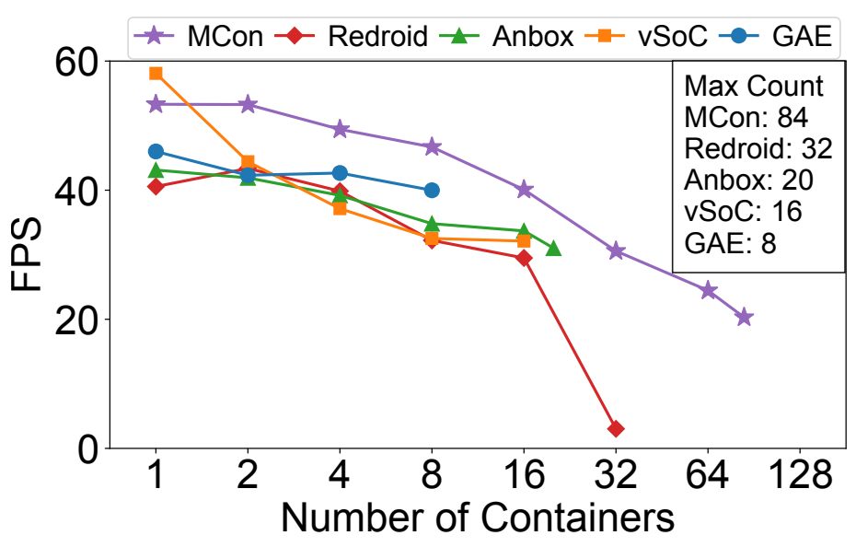
Less Framework Memory Enables Higher Density
The same server supports more active tenants before hitting a different limit.
70–82% less
per-tenant host memory
with active app workloads
84 vs. 32
maximum active tenants:
MCon vs. Redroid
23
Notes:
Consolidation also reduces the total per-tenant host-memory footprint by seventy to eighty-two percent under active app workloads.
On our test server, MCon supports eighty-four active tenants, versus thirty-two for Redroid, the strongest baseline.
Baselines die because of host-memory pressure. MCon removes the host memory wall, its curve going all the way down (since GPU power saturates) till 84 tenants, due to fragmented GPU memory preventing new graphics-context allocations.

Slide 24
Conclusion
Elastic Android containers do not have to
duplicate the full framework.
•
Framework namespaces construct private tenant views.
•
Device slices separate performance-critical execution.
•
Together, they make Android environments more elastic.
0.99 s allocation 70–82% less host memory
+56% end-to-end GUI Agent RL speed at Infinigence AI
Code & docs: github.com/VirtualSoC/mcon-docs, and special thanks to Tsinghua Deng Feng Fund
24
Notes:
To conclude, Mcon demonstrates that it is possible for Android containers to not duplicate the full framework.
In production at Infinigence AI, MCon improves end-to-end RL training speed by 56%.
Thank you. I'm happy to take questions.

Slide 25
Isolation Model and Tradeoffs
Target: single-provider, semi-trusted clusters
Curious, buggy, or noisy tenants—not mutually distrustful public-cloud workloads.
Framework state
Namespaces + typed IPC policies
Direct kernel paths
Android UID-based isolation
Resource interference
CPU / memory limits, IPC regulation, slices and pacing
The framework remains trusted and shared.
Its compromise or failure can affect all co-located tenants.
25
Notes:
The shared framework remains trusted. A framework compromise can affect all co-located tenants, and a framework crash interrupts their apps.
MCon targets single-provider, semi-trusted clusters, such as internal training and testing farms. To deploy Mcon over distrustful public-cloud workloads, we need to introduce container hierarchies, such as allocating a dedicated Mcon instance for each cloud user account.

